Slide 1


Farmer’s Assistance
Team Members: Kailash Maharaj, Yajesh Maharaj
Team Name: More Code
Trinidad & Tobago

Slide 2

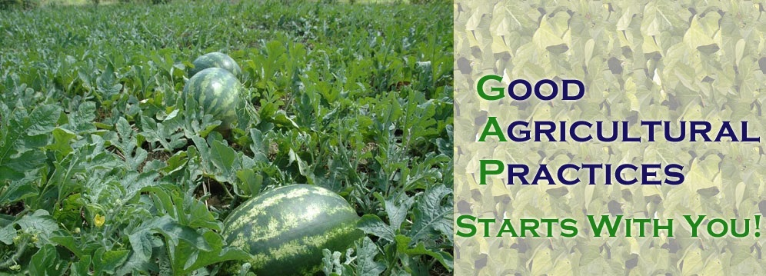
Farmers have poor seasonal crop management and not enough access to information.
Notes:
These problems result in:
Poor crop production
Negative impact on the food security of the nation
Loss of investment

Slide 3

TTFarm
TTFarm solves these problems by:
Making knowledge about crops readily available to farmers
Enabling farmers with tools such as crop planning and crop optimization
Crop planning will assist farmers with planning how the plant and would give them an insight as to what income returns they would get, based on what they are going to plant, and in what quantity

Slide 4
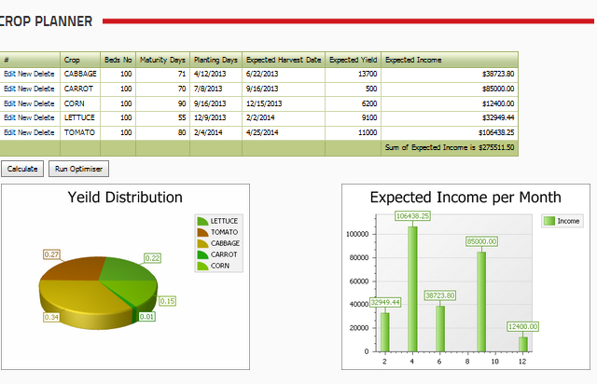
Open Source Data
TTFarm is able to provide these to farmers by using average price data from previous years
Through different analysis stages, different tools were created based on the month, and price of the crop
Models were built based on these two factors to assist farmers with seasonal crop planting and also with seeing how their yield and income can or should be
Notes:
How does TTFarm solve farmers’ problems?
Knowledge is given to them about crops, machinery, protective gear, farming techniques
They are provided with tools to:
Calculate their yield income
Plan their crop
Get and optimized plan

Slide 5
DEMO
Notes:
With the knowledge provided and the tools made available, farmers will no long have a problem with planting crops in the wrong season.
They will also be able to see seasonal trends against price of crops
This will ensure that farmers do not lose investment and have proper seasonal management
This model will decrease farmers’ problems substantially

Slide 6


